Slide 1
Monday Morning Meeting

Slide 2
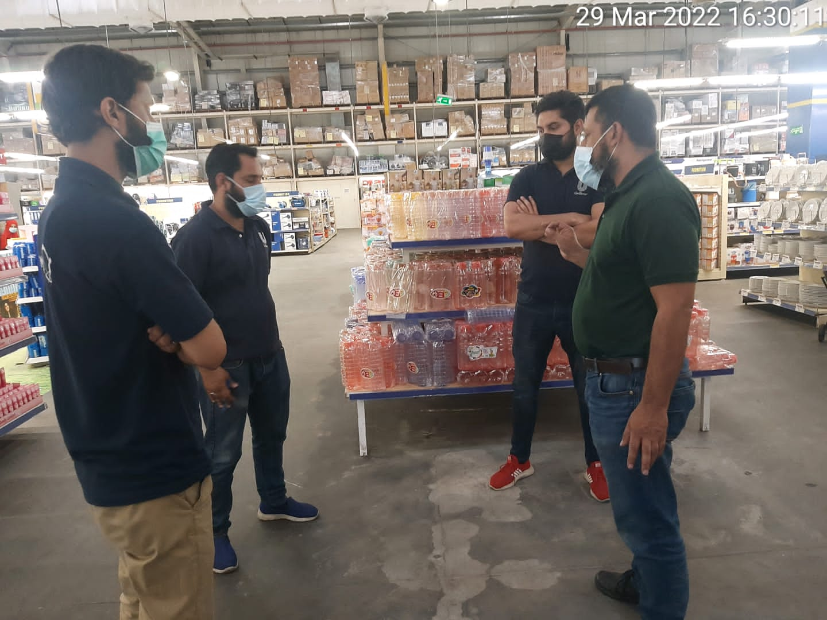
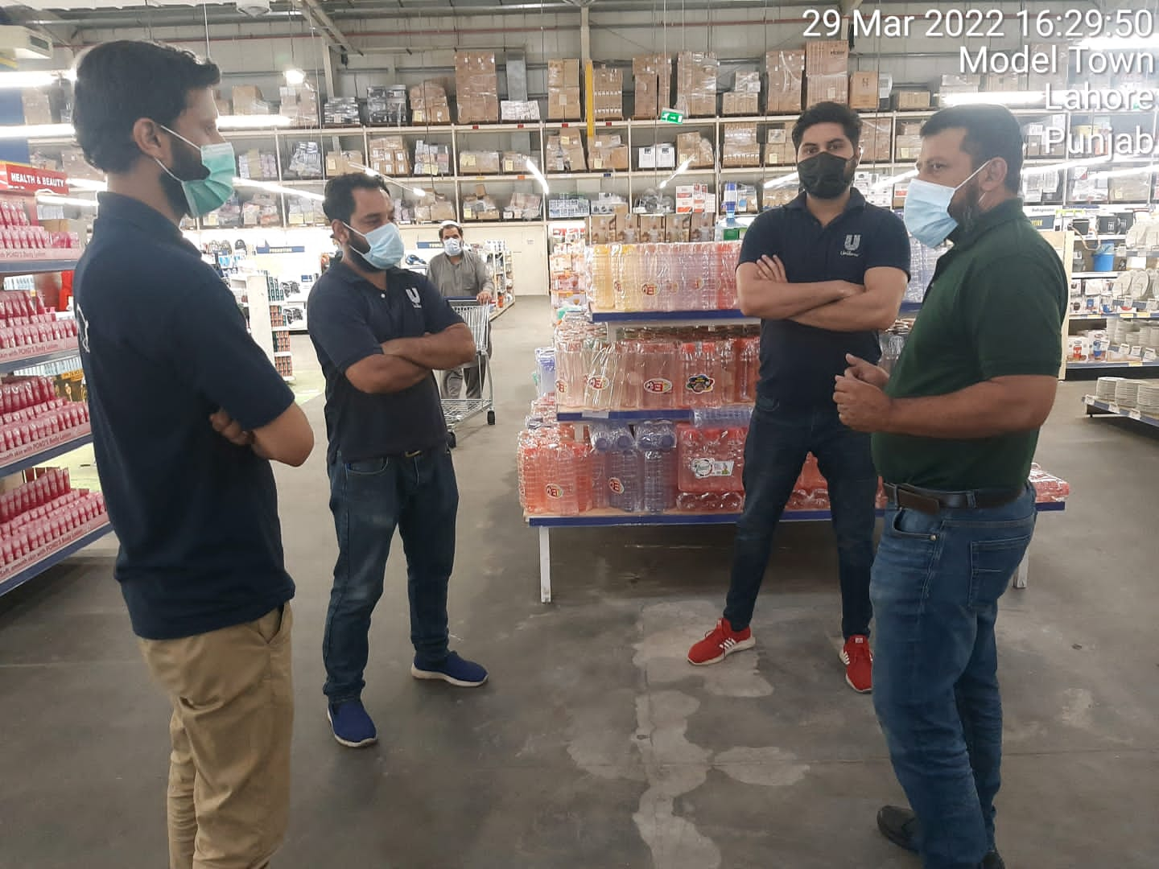
Metro Model Town
GROOMING (Hair cutting, Shoes polish, Neat and clean uniform
SAFETY (Maintain Bike with HELMET, Fog light ,Side mirror, indicators
SAFETY IN STORE (Wear Mask, sanitizer use, Distance from lifter, social distance ,know about emergency exit
Smollan values
Stocks filling
Shelves cleaning
Missing raicard
Zero articles
Block articles

Slide 3
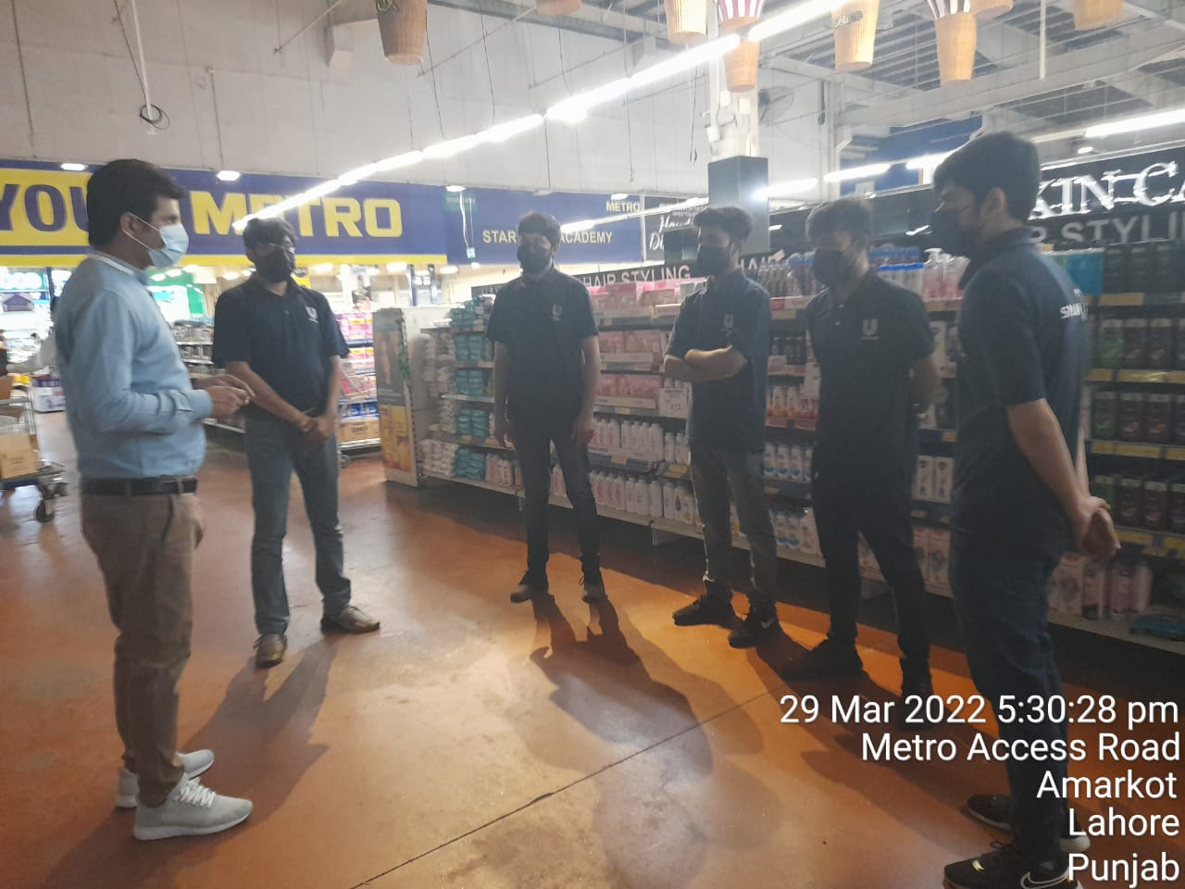
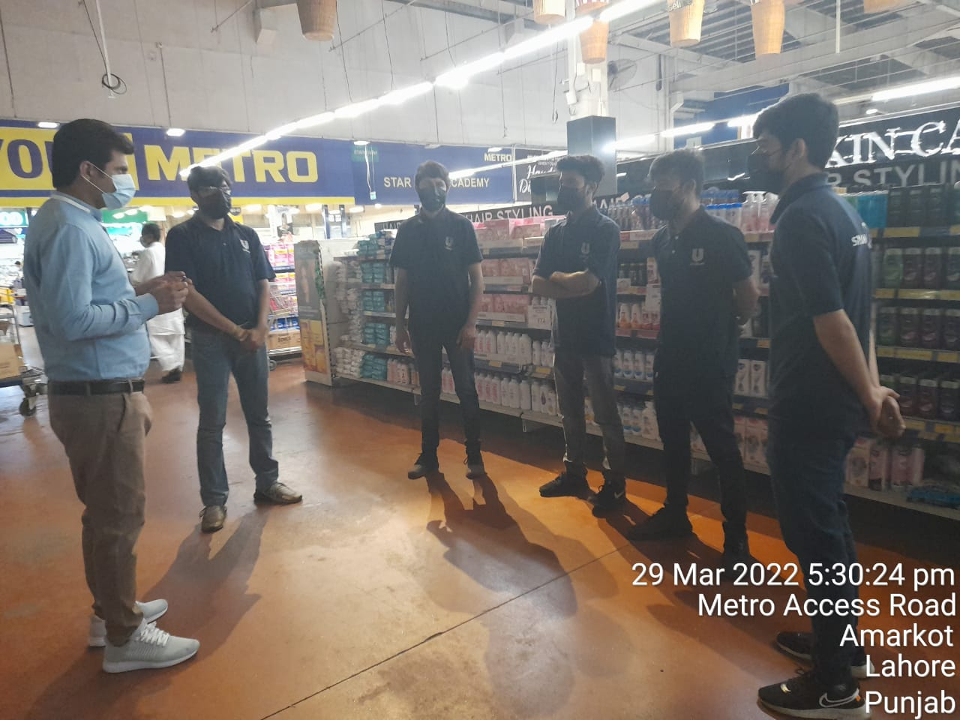
Metro Thokar
GROOMING
(Hair cutting, Shoes polish, Neat and clean uniform
SAFETY IN STORE (Wear Mask, sanitizer use, Distance from lifter, social distance ,know about emergency exit
Smollan values
Stocks filling
Shelves cleaning
Missing raicard
Zero articles
Corona safety instruction

Slide 4
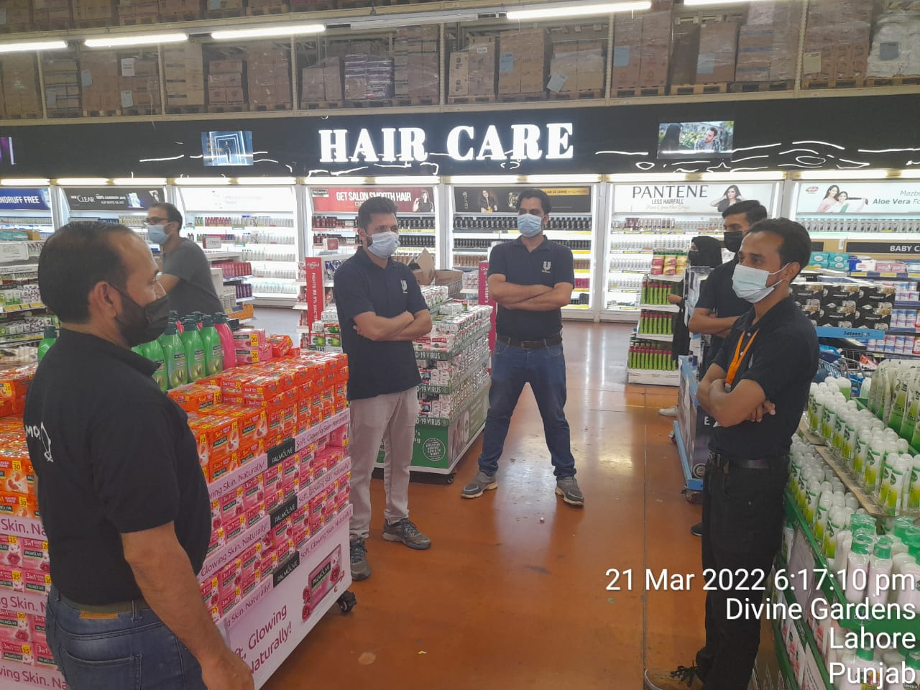
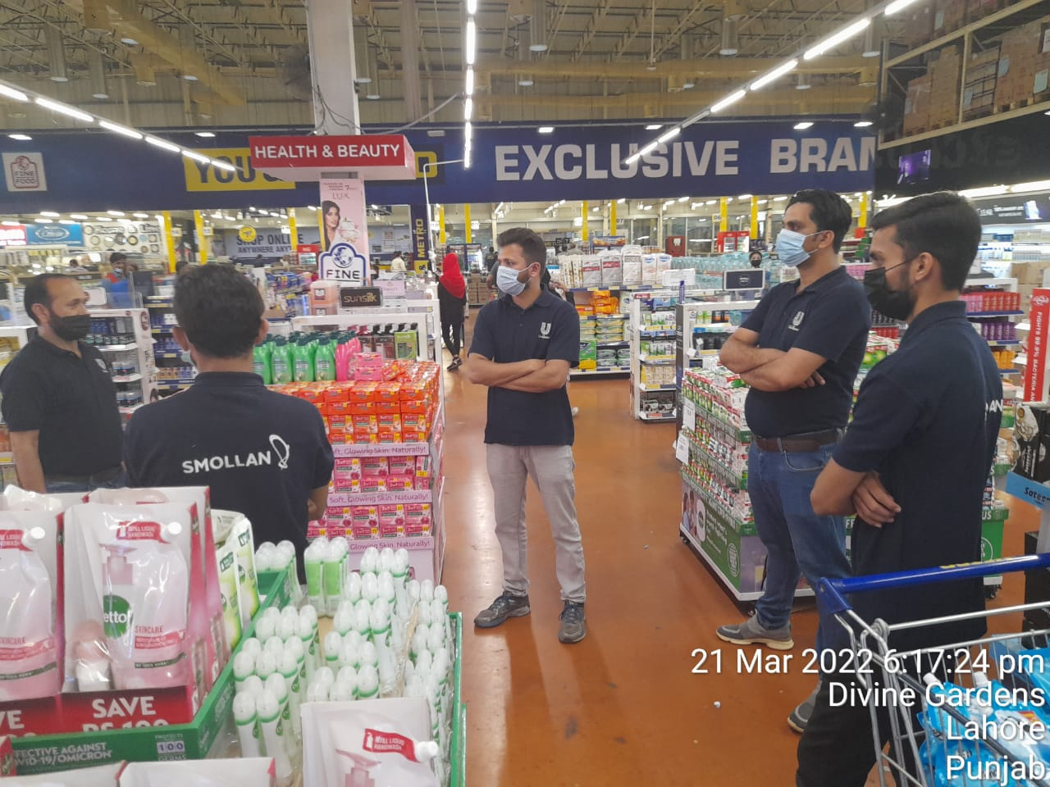
Metro DHA
Check personal hygiene
Drive bike carefully during fog and rainy season
Proper attendance &check-in
No annual leaves
Check product mrp and shelf price

Slide 5
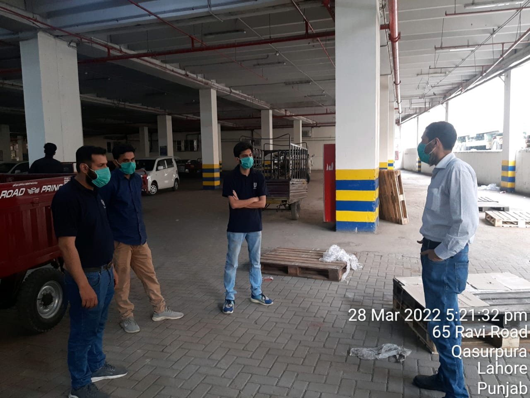
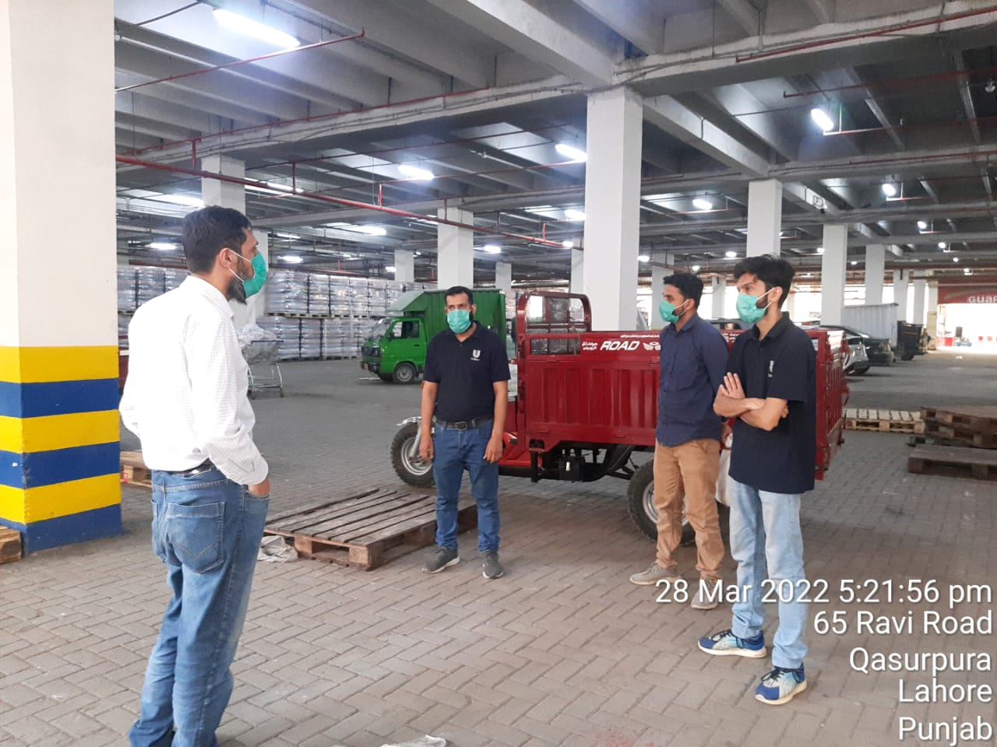
Metro Ravi
GROOMING (Hair cutting, Shoes polish, Neat and clean uniform
SAFETY (Maintain Bike with HELMET, Fog light ,Side mirror, indicators
SAFETY IN STORE (Wear Mask, sanitizer use, Distance from lifter, social distance ,know about emergency exit
Smollan values
Discussion on short expiry articles and managing their stocks
Shelves cleaning
Missing raicard
Zero articles
Medical claims form filling

Slide 6
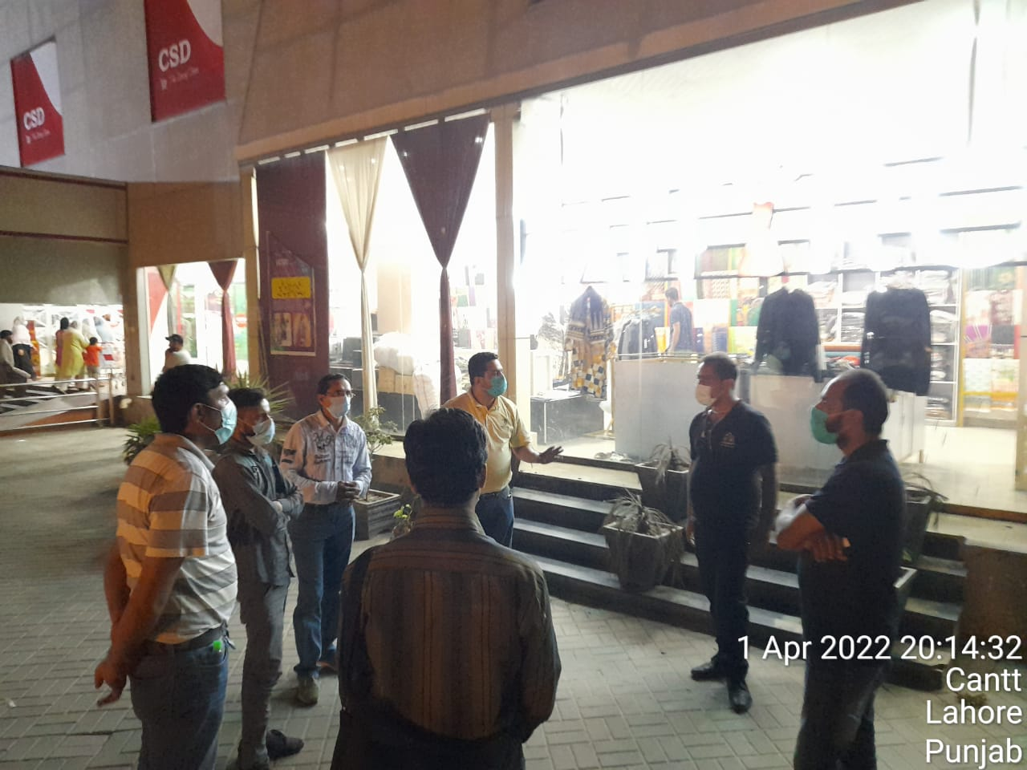
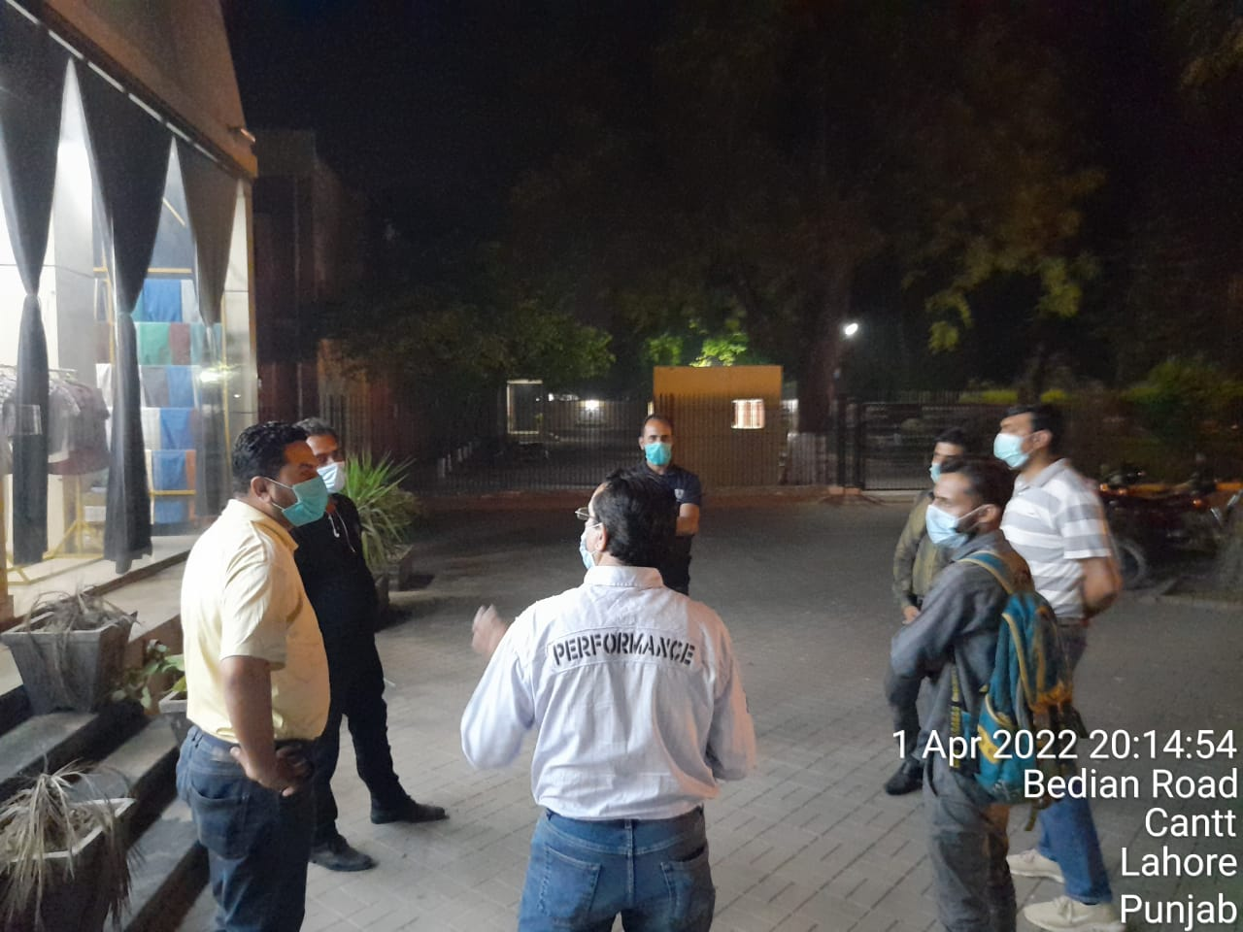
UCD & CSE
GROOMING (Hair cutting, Shoes polish, Neat and clean uniform
SAFETY (Maintain Bike with HELMET, Fog light ,Side mirror, indicators
SAFETY IN STORE (Wear Mask, sanitizer use, Distance from lifter, social distance ,know about emergency exit
Smollan values
Discussion on short expiry articles and managing their stocks
Shelves cleaning
Missing raicard
Zero articles
Medical claims form filling

